Slide 2


NTS Retail
Seamless customer journey

Slide 3

Consumers expect a unique brand experience across all channels.
By leveraging the complementary value each channel has to offer,
CSPs benefit from significant improvements in service experience and sales performance.

Slide 4
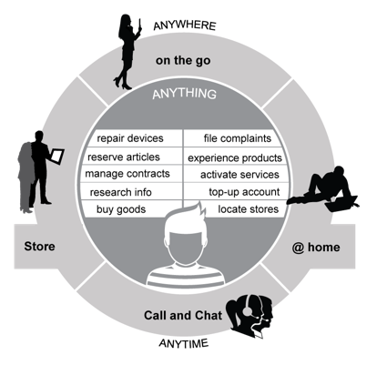
Anything, anytime, anywhere -
Put your customer center stage

Slide 5

  NTS Retail offers a smart way to share business processes and data across any channel, system or device.
  It enables you to seamlessly interlink your retail stores with your eCommerce / BSS back end to:
  Create a true omni-channel experience
  Boost customer engagement
  Drive sales

Slide 6
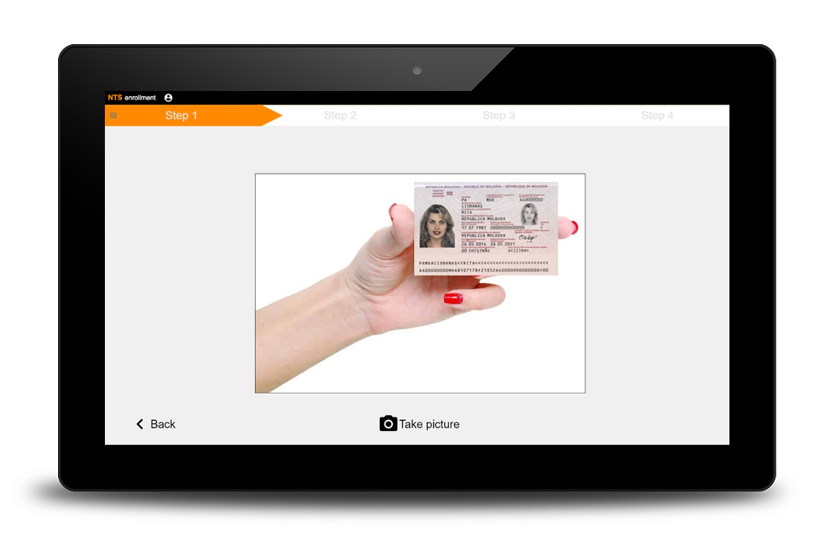
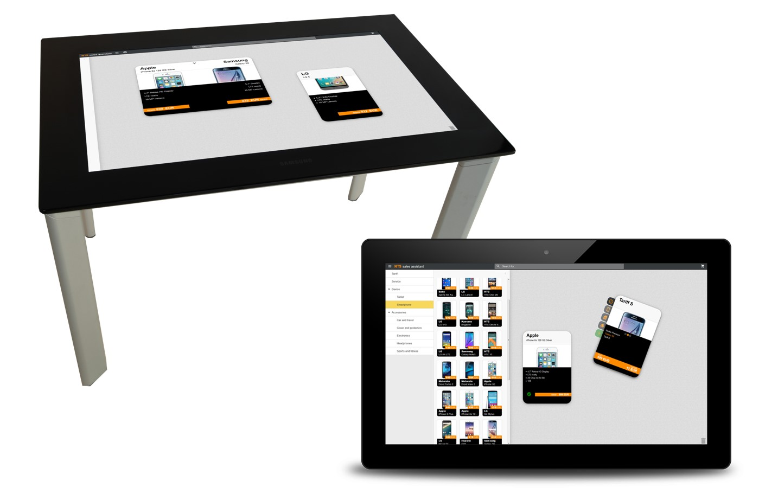



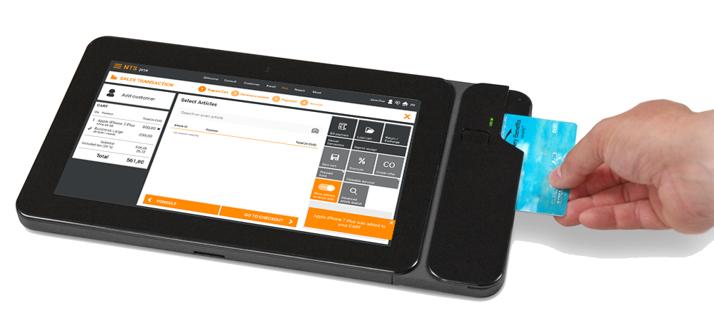
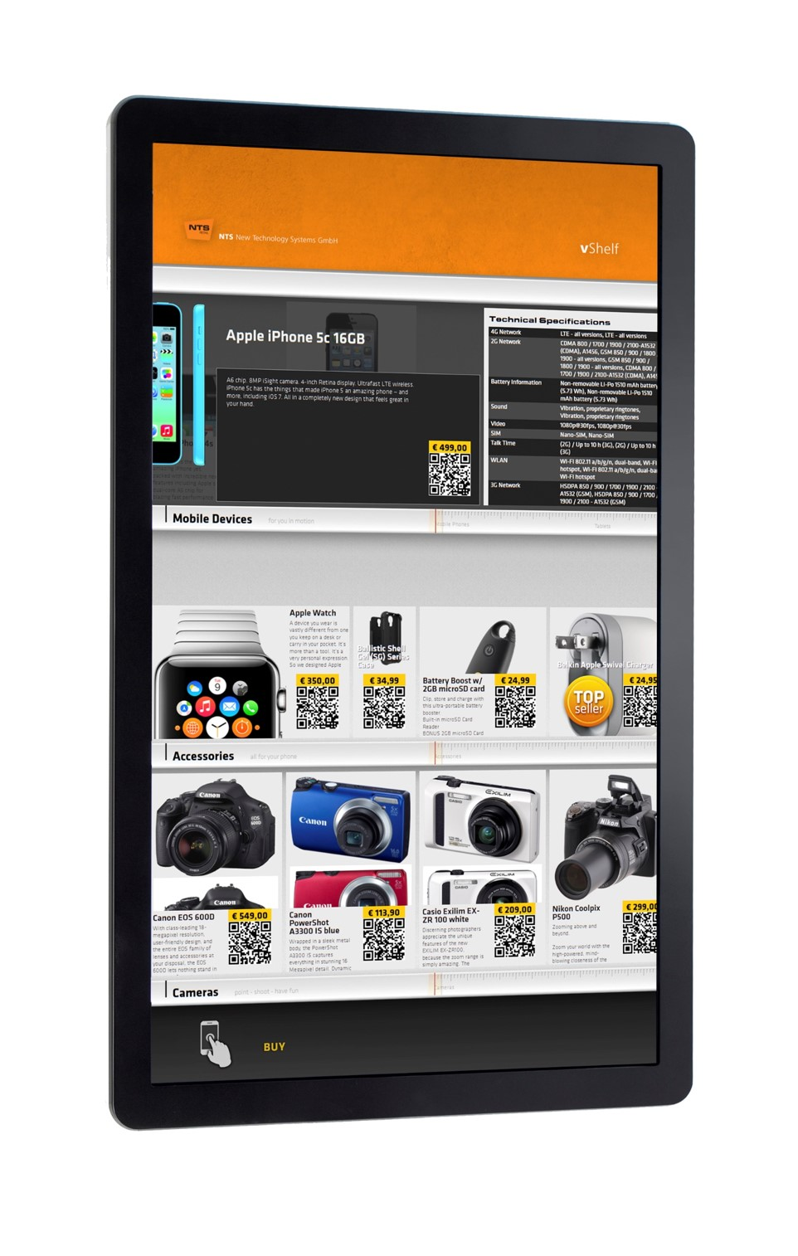



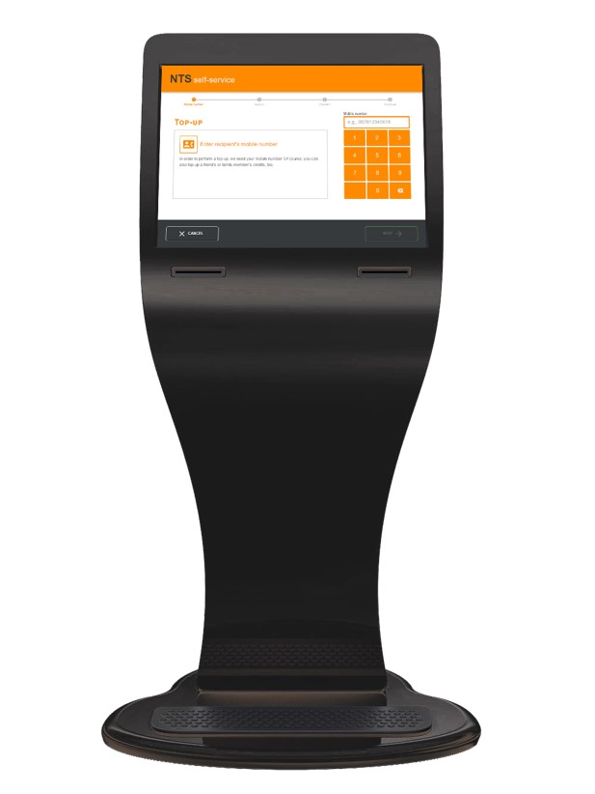


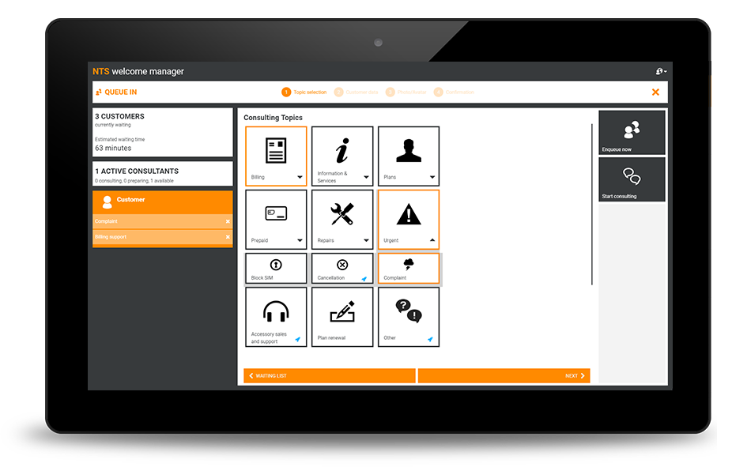
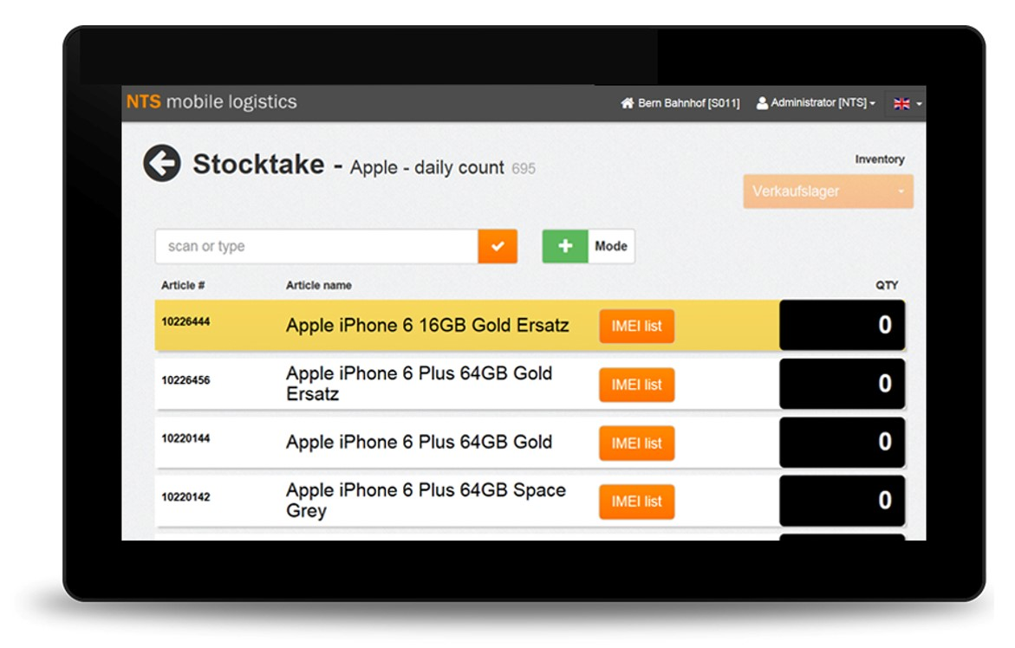


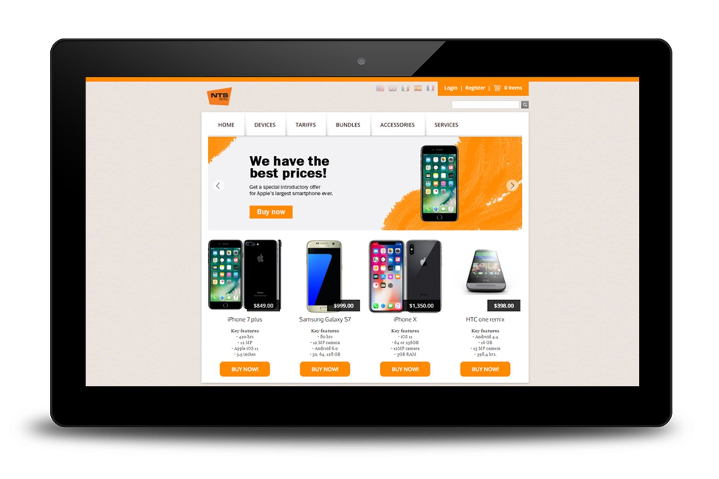
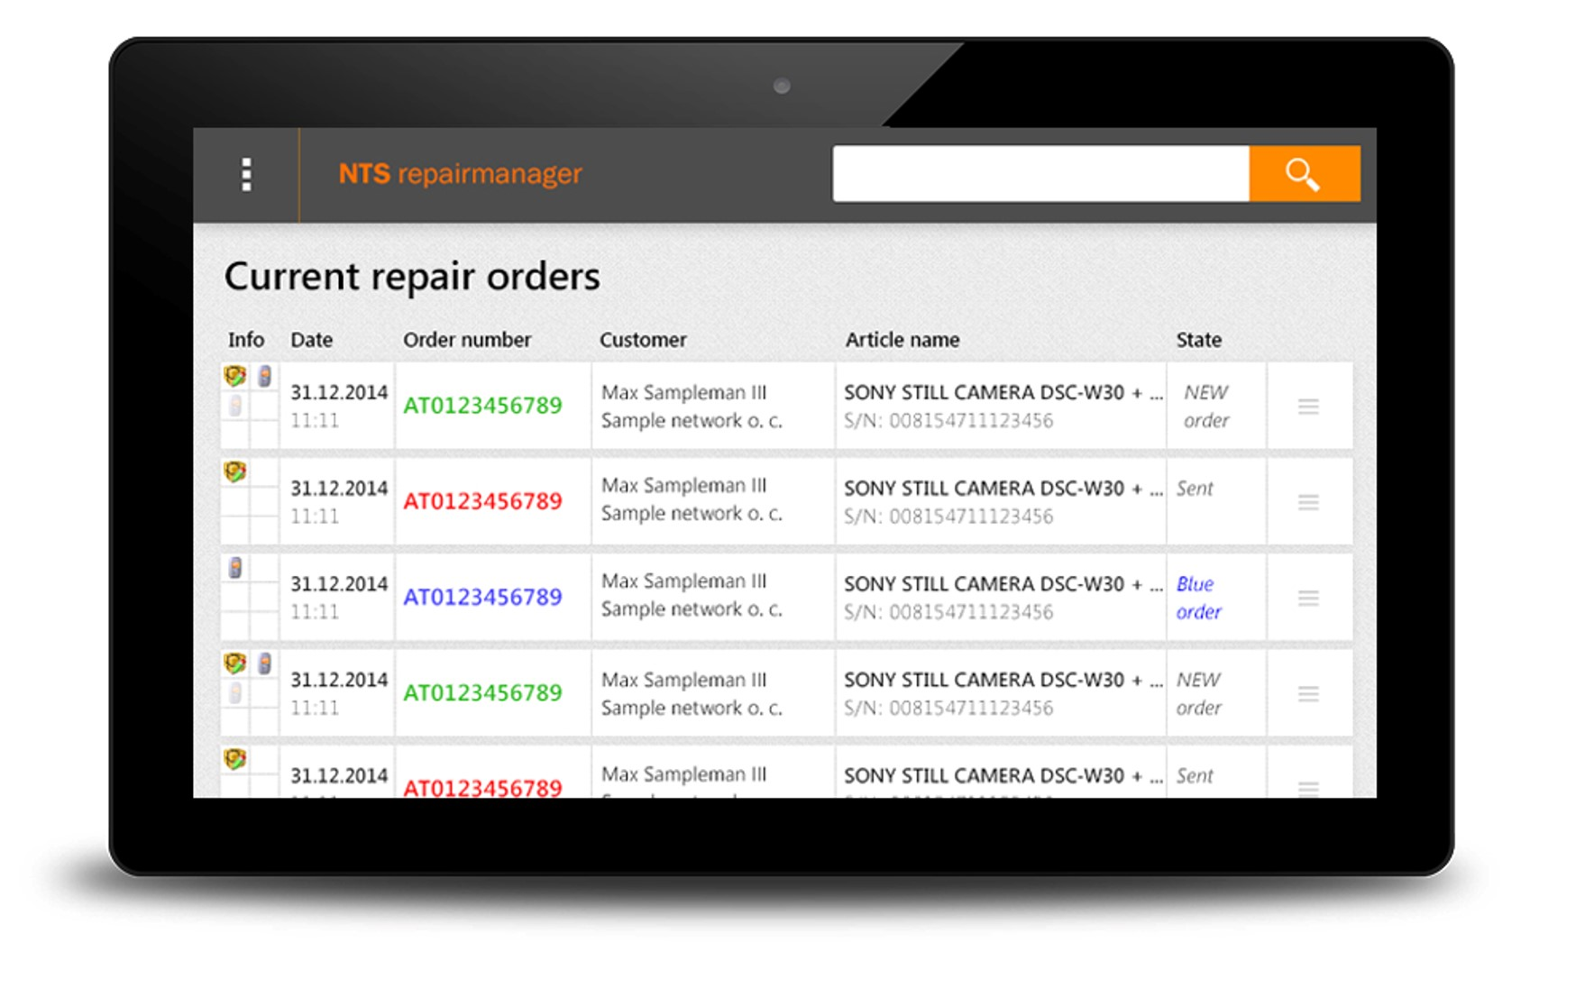
Assisted /
Guided Selling
Enrollment
UPGRADE
TARIFF PLANS
GET ASSISTANCE
BUY PRODUCTS
POS /
Mobile POS
Digital Signage
Self-Service /
Checkout
EXPLORE OFFERS
PERFORM
TOP-UPS
Welcome &
Queue Management
GO TO
STORE
USE HOME DELIVERY
Stock
Management
COMMERCE
PLATFORM
eShop
DO ONLINE RESEARCH
ARRANGE
FOR REPAIRS
After-Sales Services
A unified solution for a seamless customer journey
Notes:
everything to edit
7 Uhr

Slide 7
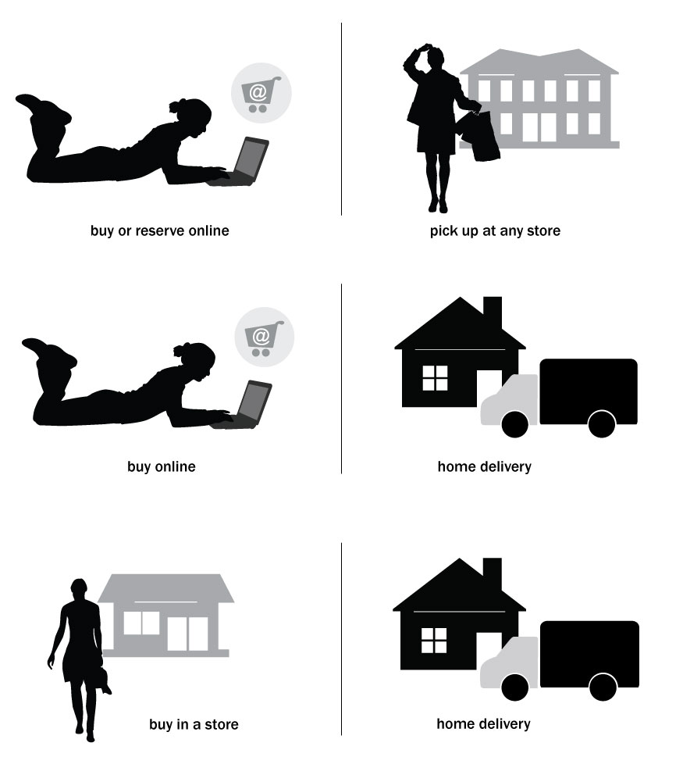
Omni-channel use cases
NTS Retail allows you to incorporate
omni-channel business cases such as:
Online purchase or reservation with pick-up at any store
(“Click & Collect“)
Online purchase with goods return in the store
In-store purchase with delivery by a third-party supplier
Online or in-store purchase with home delivery

Slide 8
Order online & pick-up in store (click & collect)
product orders
online
Buy or reserve items based on catalogue availability and store locations
NTS Retail’s click & collect functionality covers three main aspects:
Online product orders / reservations
Query stock information
Order processing at the POS
order processing
stock information
In-store
online
Pick-up and finalize order at the store. Use cross-selling potential.
Real-time information about product availabilities

Slide 9

A seamless customer journey

Slide 10

1| Start online
Research and buy/reserve products online for pickup in store. Create store appointments online

Slide 11
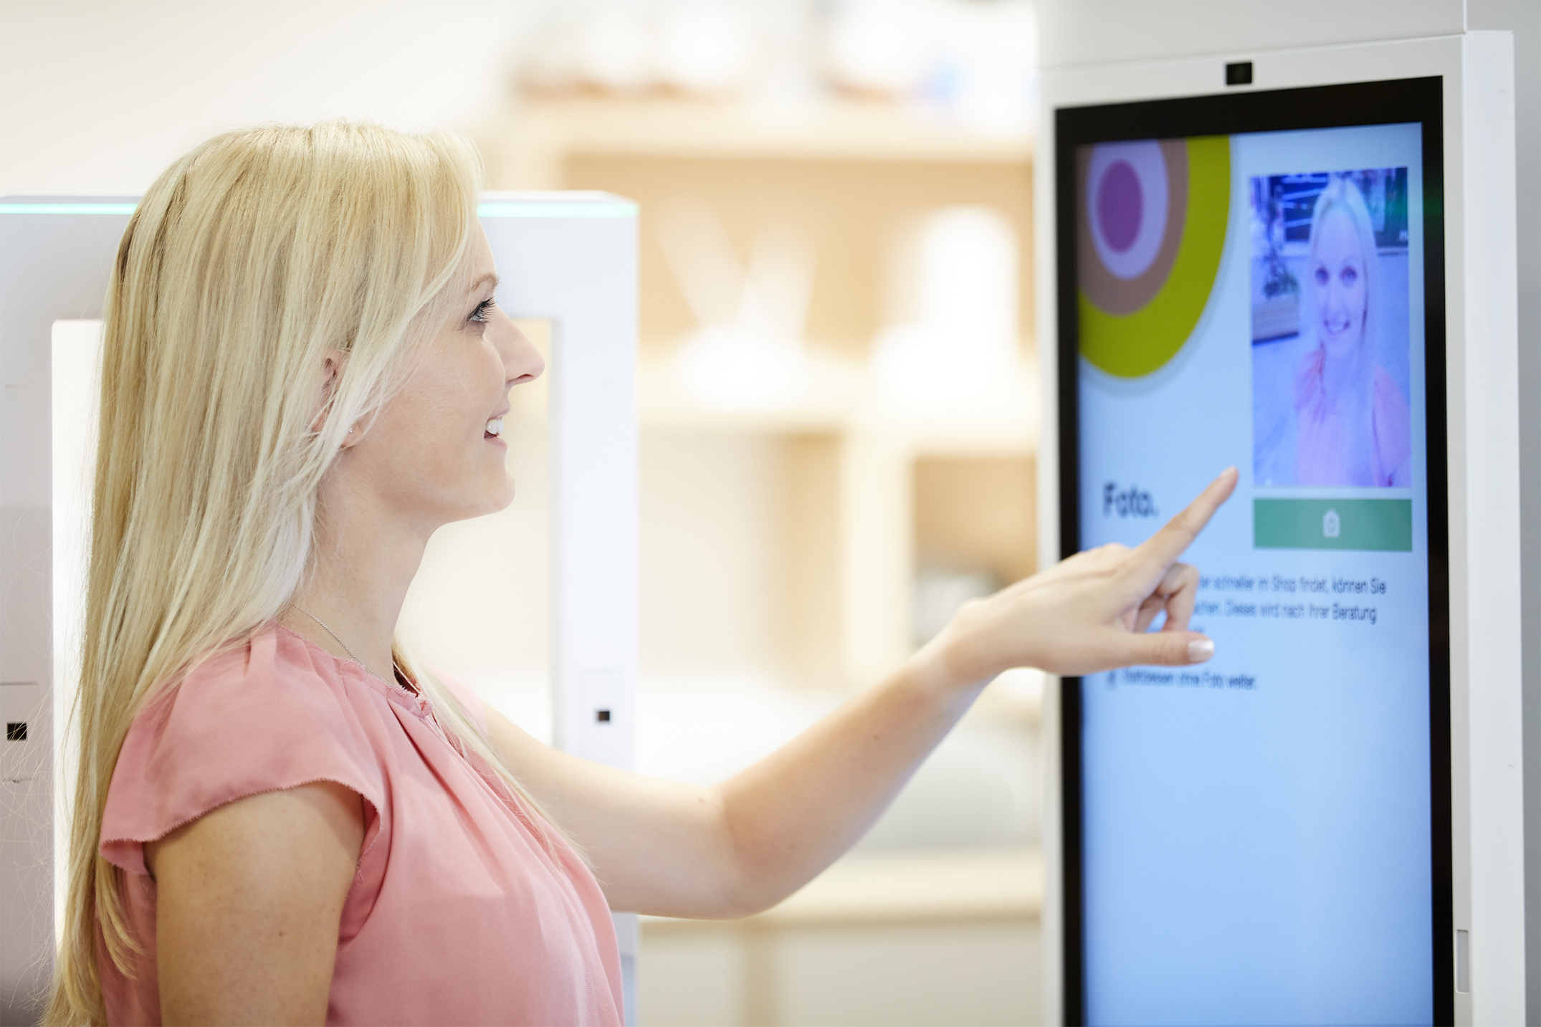
2a| Visit store
Check in at the self-service kiosk

Slide 12
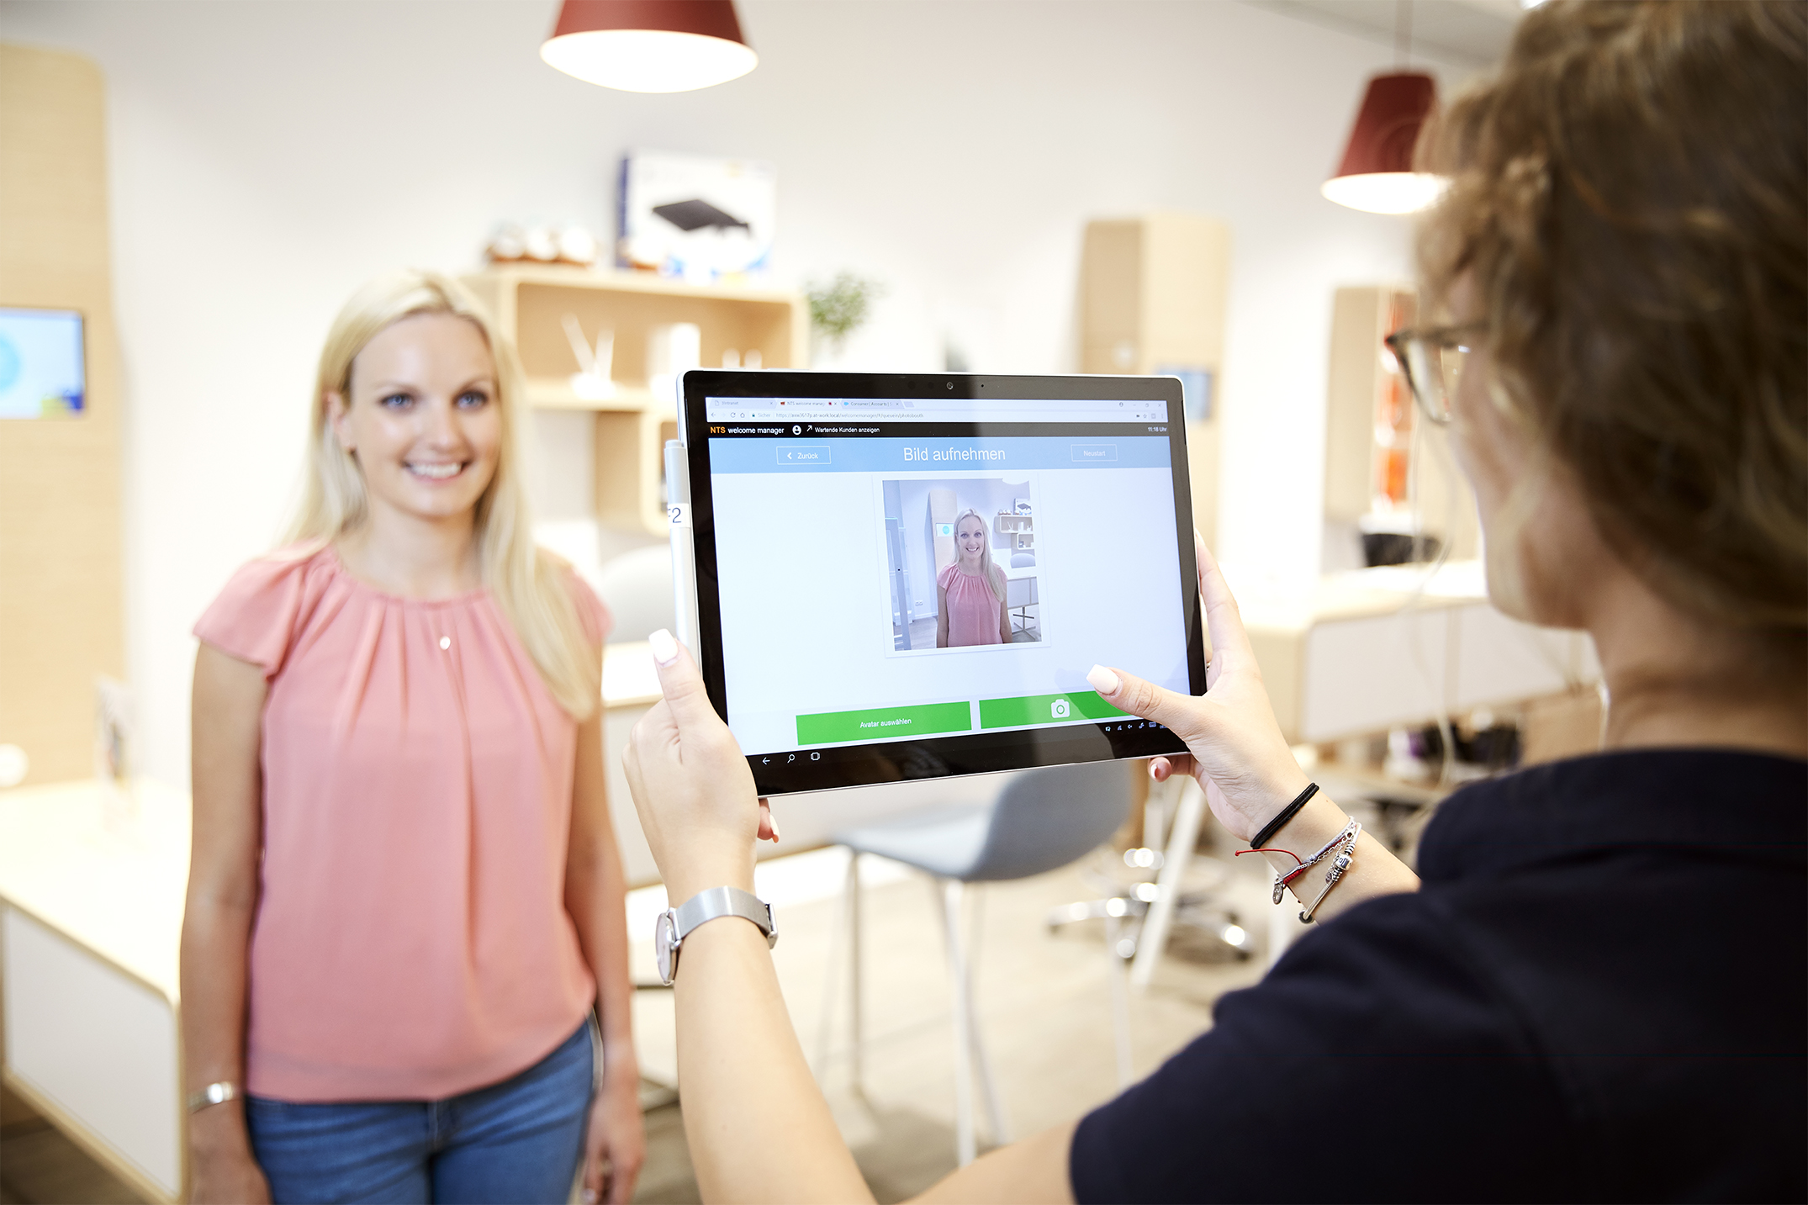
2b| Visit store
Check in at the store, assisted by a dedicated welcome agent

Slide 13
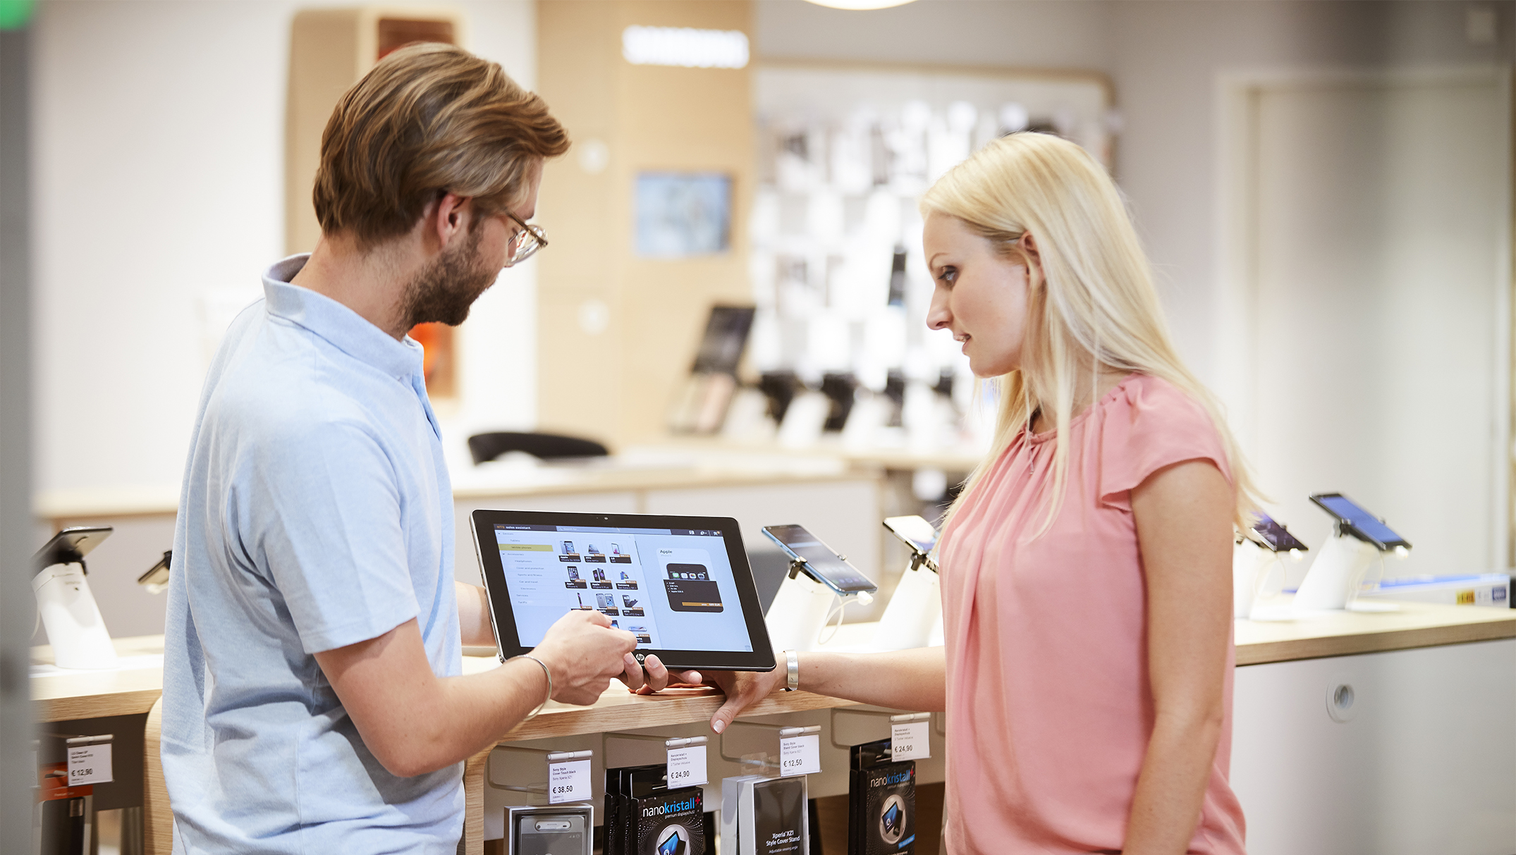
3| Engage
Empower sales staff to guide clients to the right purchasing decision

Slide 14

4| Enroll
Streamline customer registration
and order entry

Slide 15
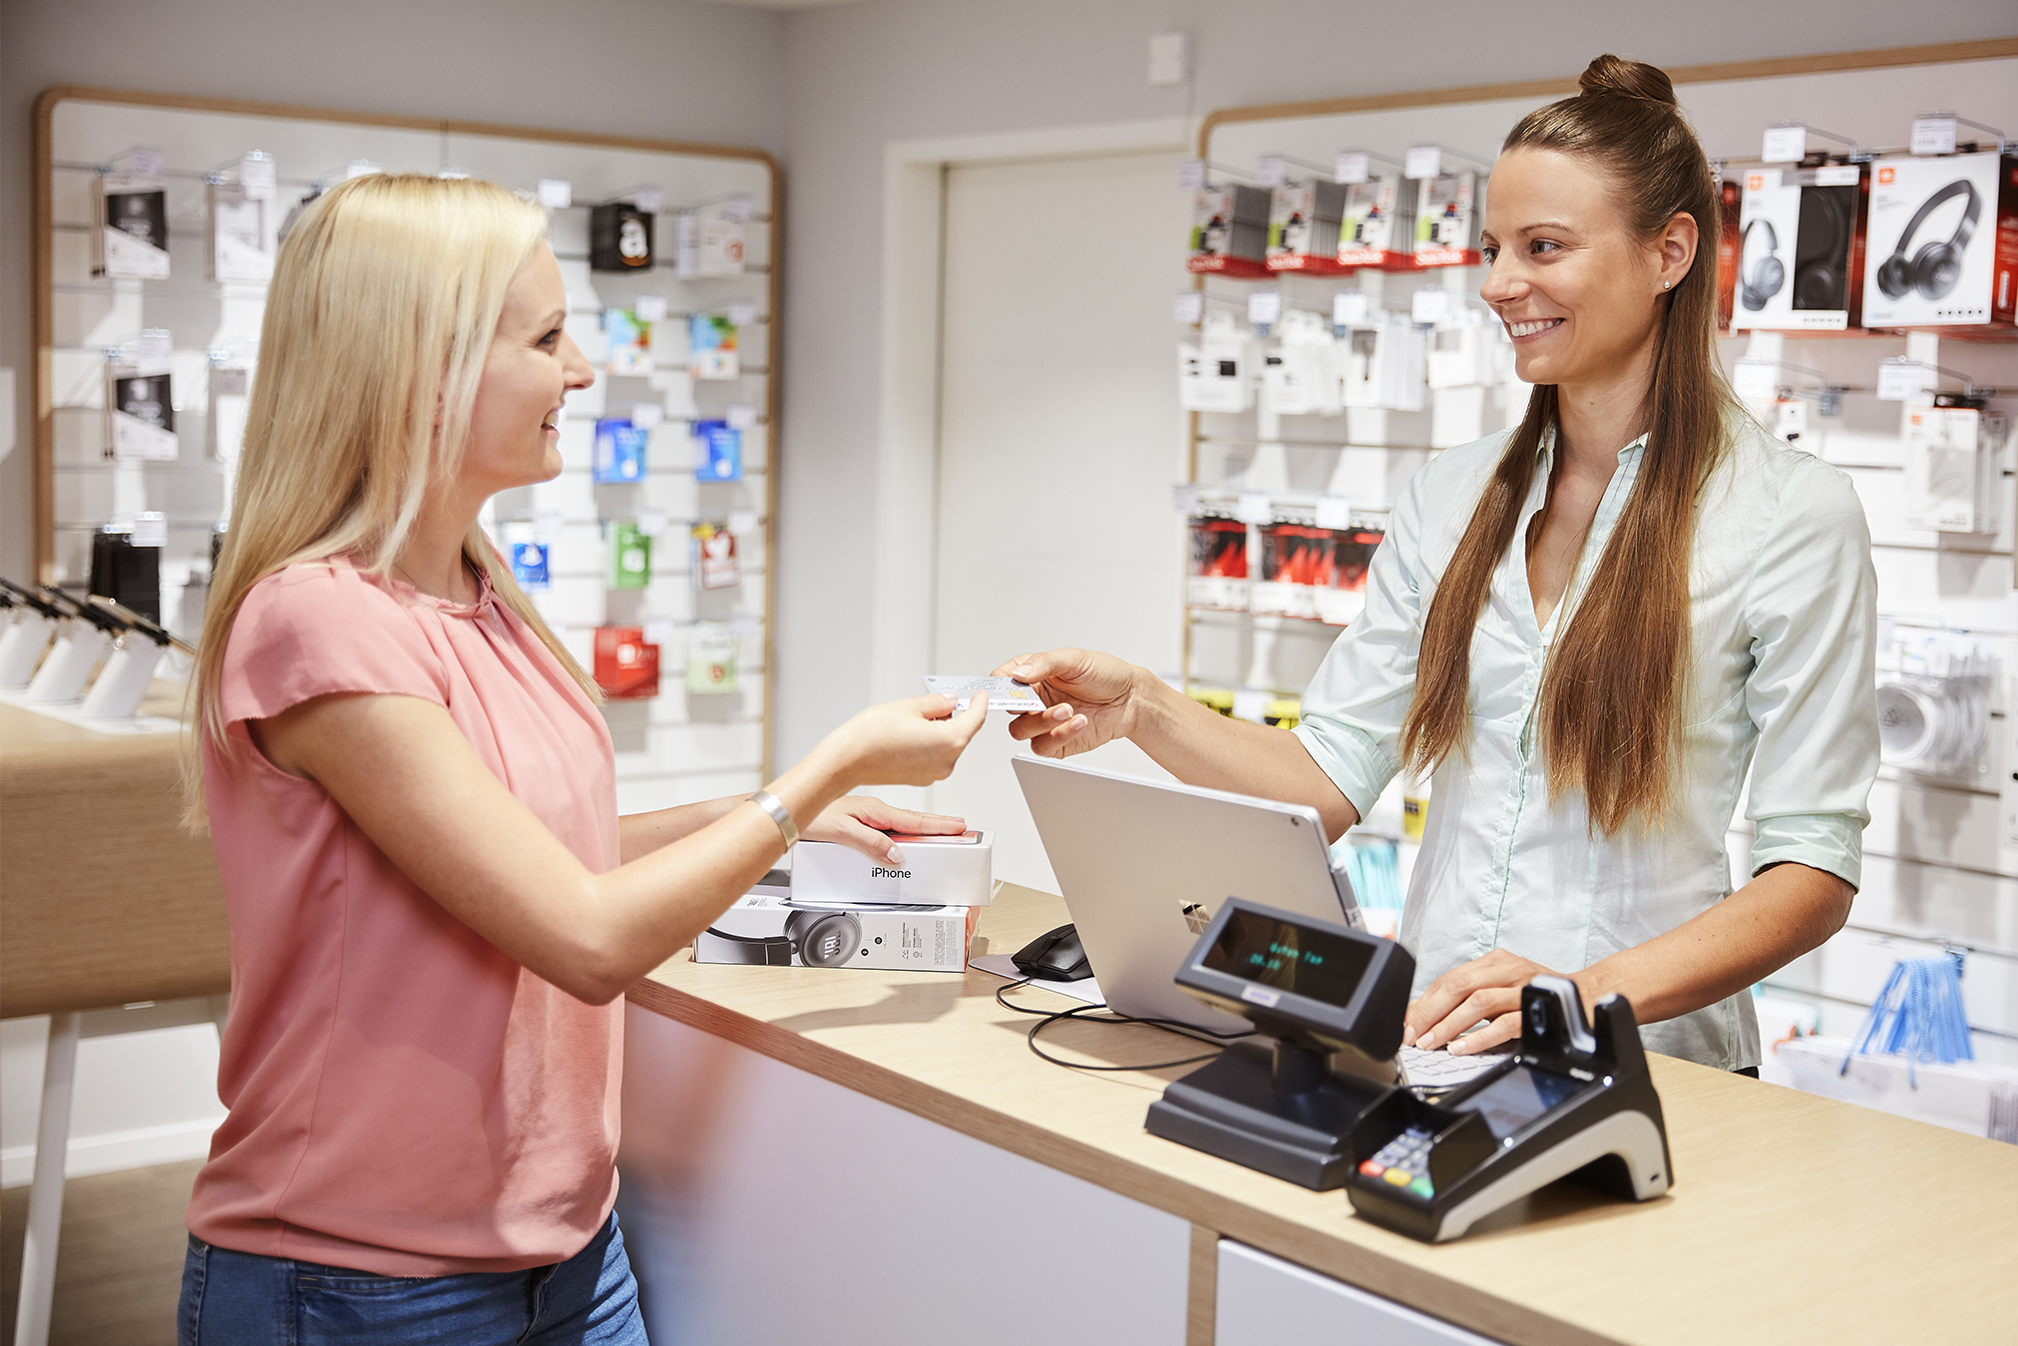
5| Checkout
Seamless handover to POS for a smooth checkout

Slide 16

6| Analyze
Gain customer insights, track customer / staff interaction / capture customer feedback

Slide 17



Click & collect process
CLICK
COLLECT
Explore products
Check stock
Reserve product
Submit reservation & get confirmation
Scan order confirmation
Check order
Add on consulting
Add
products
Finalize transaction
Receipt / email
Pick-up items
Send basket transaction
Cash drawer, EFT
Receipt printers
NTS Retail Suite
Order ID
Customer ID
Store ID
Product offers, advertisements
NTS stock & reservation service
NTS basket / cart
NTS point of sale
NTS stock management
NTS Retail Database
BSS / OSS Connectors
E-Commerce
Product Catalog
ERP
CRM
Payment gw

Slide 18
Your benefits
1 | Create a smooth and consistent service experience across all customer touchpoints.
2 | Boost customer engagement by offering a personalized customer service.
3 | Increase conversion and attach rates through cross-channel sales and consultative selling.
4 | Achieve highest product availability by providing 360° view on inventory and orders.
5 | Better understand your customers’ demands and their path to purchase.

Slide 19
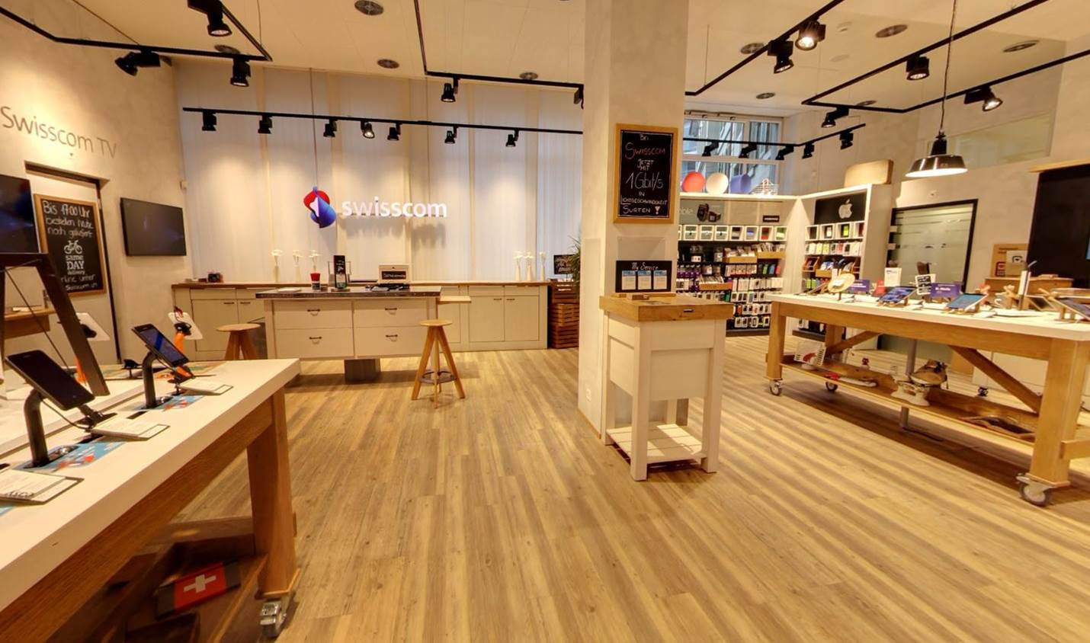
“With NTS Retail, Swisscom was able to further expand our service portfolio. This brings us
closer to our customers and ensures the best possible cross-channel shopping experience.”
Urs Lehmann, Shop Management, Swisscom AG

Slide 20
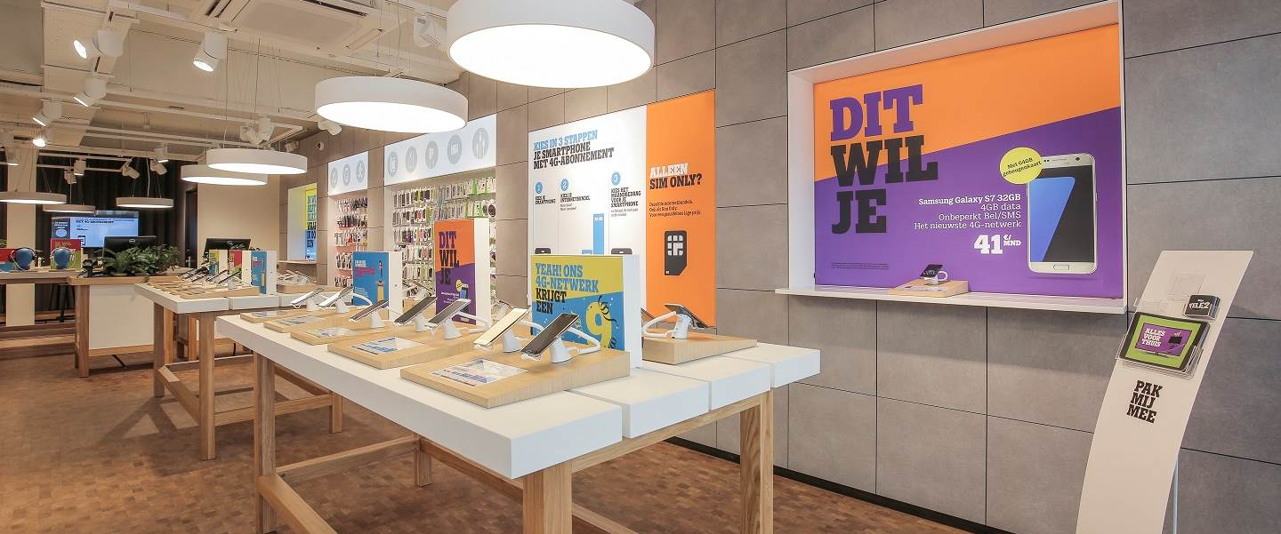
Tele2 Netherlands
Tele2 Netherlands had a clear idea of a future-proof store concept: No more stationary sales counters. A paperless store with digitalized receipts and contracts to increase customer convenience. A click & collect service to provide a seamless omni-channel brand experience and unlock cross-selling potentials. Simplification of eToUp handling with a seamless tracking of prepaid credit sales. No more costs for scratch card production. Together with NTS Retail, Tele2 realized this compelling store concept in only 16 weeks and started business right in time for Christmas sales.

Slide 21
Contact us
for more details
about our products
and services.

